Slide 1


Shri Vaishnav Vidyapeeth Vishwavidyalaya
Session 2019-20 (July - December)
Topic : TELNET
Submitted to :
Mr. Saurabh Sharma Sir
Submitted by :
Mahiransh Sharma Kritik Pancholi
(18100BTCMCI02957) (18100BTCMCI02955)

Slide 2


Introduction to TELNET
The name stands for "teletype network". Historically, Telnet provided access to a command-line interface (usually, of an operating system) on a remote host.
Telnet is an application protocol used on the Internet or local area network to provide a bidirectional interactive text-oriented communication facility using a virtual terminal connection. User data is interspersed in-band with Telnet control information in an 8-bit byte oriented data connection over the Transmission Control Protocol (TCP).

Slide 3
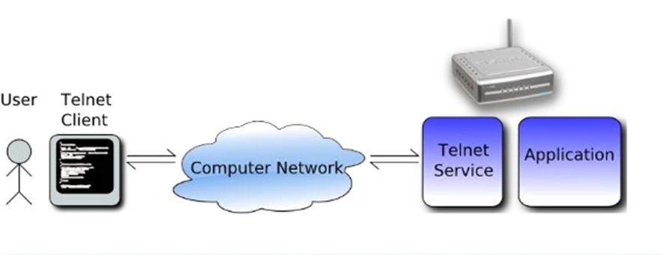
Introduction to TELNET

Slide 4
History and Standards
Telnet is a client-server protocol, based on a reliable connection-oriented transport. Typically, this protocol is used to establish a connection to Transmission Control Protocol (TCP) port number 23, where a Telnet server application (telnetd) is listening. Telnet, however, predates TCP/IP and was originally run over Network Control Program (NCP) protocols.
Even though Telnet was an ad hoc protocol with no official definition until March 5, 1973, the name actually referred to Teletype Over Network Protocol as the RFC 206 (NIC 7176) on Telnet makes the connection clear.

Slide 5
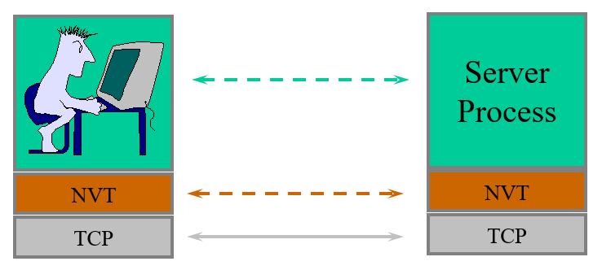
Network Virtual Terminal

Slide 6
Network Virtual Terminal
A network virtual terminal is a communications concept describing a variety of data terminal equipment (DTE), with different data rates, protocols, codes and formats, accommodated in the same network.
This is done as a result of network processing where each device’s data is converted into a network standard format, then converted into the format of the receiving device at the destination end.

Slide 7
TELNET vs telnet
TELNET:
TELNET is a protocol that provides “a general, bi-directional, eight-bit byte oriented communications facility”. The TELNET protocol is based upon the notion of a virtual teletype, employing a 7-bit ASCII character set. The primary function of a User TELNET, then, is to provide the means by which its users can 'hit' all the keys on that virtual teletype.
telnet:
telnet is a program that supports the TELNET protocol over TCP.

Slide 8
The TELNET protocol (port - 23)
Reference: RFC 854
TCP connection
data and control over the same connection.
It uses default port number 23.
Network Virtual Terminal
Intermediate representation of a generic terminal.
Provides a standard language for communication of terminal control functions.

Slide 9
Control functions
TELNET includes support for a series of control functions commonly supported by servers.
This provides a uniform mechanism for communication of (the supported) control functions.
Interrupt Process (IP)
suspend/abort process.
Abort Output (AO)
send no more output to user’s terminal.

Slide 10
Control functions
Are You There (AYT)
check to see if system is still running.
Erase Character (EC)
delete last character sent
Erase Line (EL)
delete all input in current line.

Slide 11
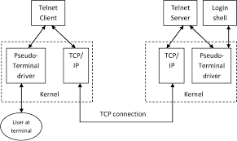
Structure of TELNET

Slide 12
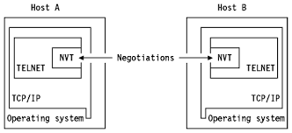
Working of TELNET

Slide 13
Telnet Negotiation
The Telnet protocol features an inline negotiation protocol to signal what features the client and server can offer each other. The client and server intersperse this negotiation data with the normal payload data. Unfortunately, it's usually the payload data that we want to match our rules against.
The telnet_negotiation preprocessor does not modify the original packet, as you might think it would. This is specifically because some rules will want to detect attacks or problems in the raw Telnet protocol, including the negotiation codes.

Slide 14
Working of Network Virtual Terminal
Telnet is designed for terminal to terminal communication and distributed computer processing.
Each host sets up a Network Virtual Terminal (NVT) and a host at one end assumes that an NVT has been set up at the other end.
This saves having to share information about each other's terminals. There is the mechanism to negotiate options so that the hosts can operate a more elaborate interface at each end using different fonts etc. than the NVT.

Slide 15
Working of Network Virtual Terminal
Each host has the right to reject requests to 'upgrade'. Option requests will fly back and forth until the optimum session is established. A request for an option that the other is already running, will not be responded to.
The User Host is the one that initiates a conversation whilst the Server Host is the one that is providing services.

Slide 16
Telnet Commands
SE - End of sub-negotiation parameters
241 NOP - No operation
242 Data Mark - Data stream part of Synch, along with TCP Urgent Pointer set
243 Break - NVT character BRK
244 IP - Interrupt Process

Slide 17
Telnet Commands
245 AO - Abort Output
246 AYT - Are You There
247 EC - Erase character
248 EL - Erase Line
249 GA - Go ahead

Slide 18
Telnet Connections
Connection is accomplished using TCP server port 23 and using many different client ports (> 1023) so that full duplex connections can occur between the server and many clients.
Typing telnet ip_address will open a connection to a telnet server. You can just type telnet on some routers and Unix boxes to give you more options e.g. open to open a connection. You will also see the Telnet option negotiations.

Slide 19
Telnet Connections
RFC 854 describes Telnet implementation and more details of the supported characters for the keyboard and printer.
RFC 2355 describes the IBM TN3270 enhancements.

Slide 20
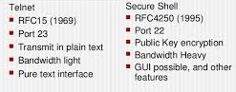
Difference between TELNET and SSH
The key difference between Telnet and SSH is that SSH uses encryption, which means that all data transmitted over a network is secure from eavesdropping.

Slide 21
Difference between TELNET and SSH
SSH is more secure compared to Telnet.
SSH encrypts the data while Telnet sends data in plain text.
SSH uses a public key for authentication while Telnet does not use any authentication.
SSH adds a bit more overhead to the bandwidth compared to Telnet.
Telnet has been all but replaced by SSH in almost all uses.
SSH and Telnet commonly serves the same purpose.

Slide 22
Thank you

